Slide 1
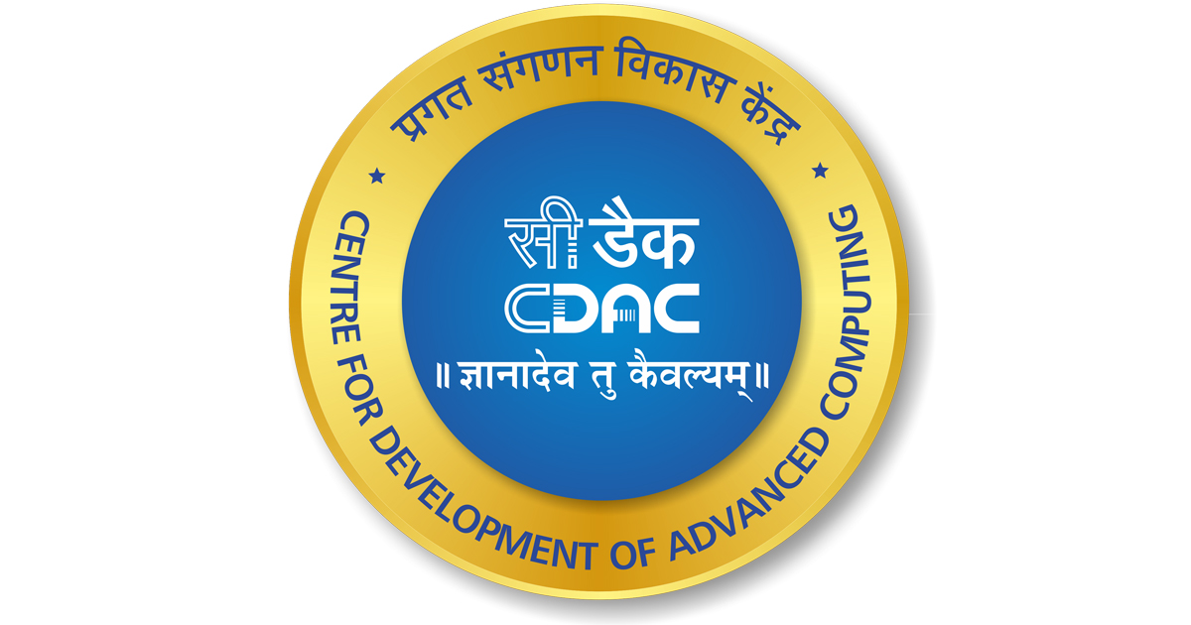

CI/CD Streamlining on DevOps with Zero-Touch Resilience
CDAC-ACTS
Presented By:
Nitesh Kumar PRN - 230940127043
Indrajeet Kumar PRN - 230940127037
Sandeep Narvade PRN - 230940127047
Ravishankar Kumar PRN - 230940127045
Guided By:
MR. Prateek Maheshwari

Slide 2

Agenda
DevOps
DevOps
DevSecOps
CI/CD Pipeline
Project Workflow
Deployment Methods : Zero-Touch Infra
Monitoring Solution
Conclusion

Slide 3
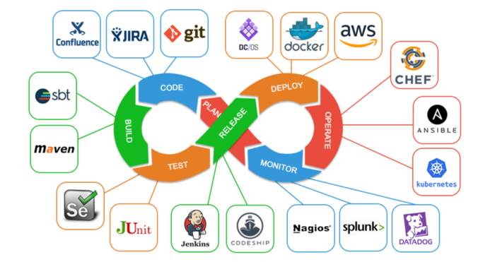
DevOps
A DevOps is a set of practices, tools, and automated processes used by development (Dev) and operations (Ops) teams to build and deploy code.

Slide 4
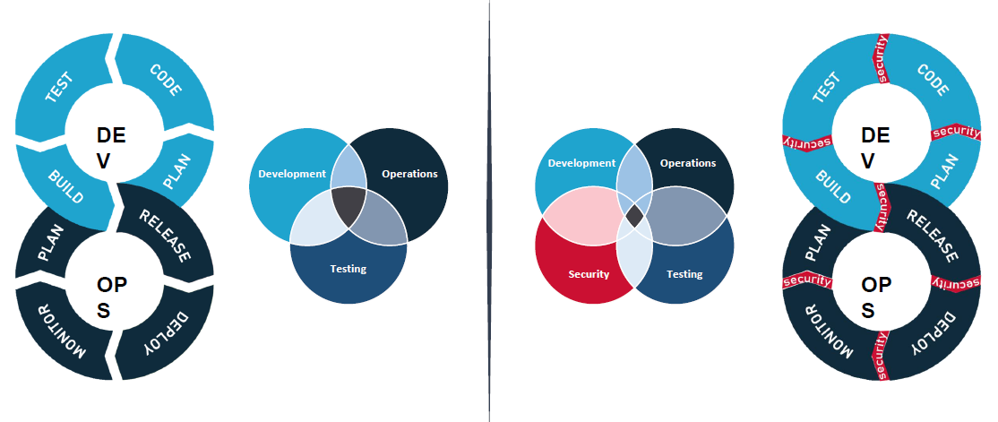
DevSecOps
DevSecOps is the practice of integrating security testing at every stage of the software development process. It includes tools and processes that encourage collaboration between developers, security specialists, and operation teams to build software that is both efficient and secure. DevSecOps brings cultural transformation that makes security a shared responsibility for everyone who is building the software.

Slide 5
Deployments Methods
Zero Touch
Light Touch
Full Touch
Zero-touch refers to a deployment or configuration process that requires no manual intervention. It is fully automated, allowing systems to be provisioned or configured without any direct human involvement
In the context of device provisioning or software deployment, a zero-touch process means that the entire procedure is automated. This is often used in large-scale deployments where minimizing manual tasks is crucial for efficiency
Light-touch involves minimal manual intervention during the deployment or configuration process. While there is some level of automation, there might be a need for human input or decision-making at certain stages.
Light-touch approaches are often used in scenarios where automation can handle most tasks, but some steps may require confirmation or customization by a user or administrator.
Full-touch implies a hands-on, manual approach to deployment or configuration. This means that a significant portion of the process requires direct human interaction, decision-making, and manual input.
Full-touch deployments are common in situations where a high degree of customization or decision-making is necessary, and automation may not be suitable for all aspects of the process.

Slide 6
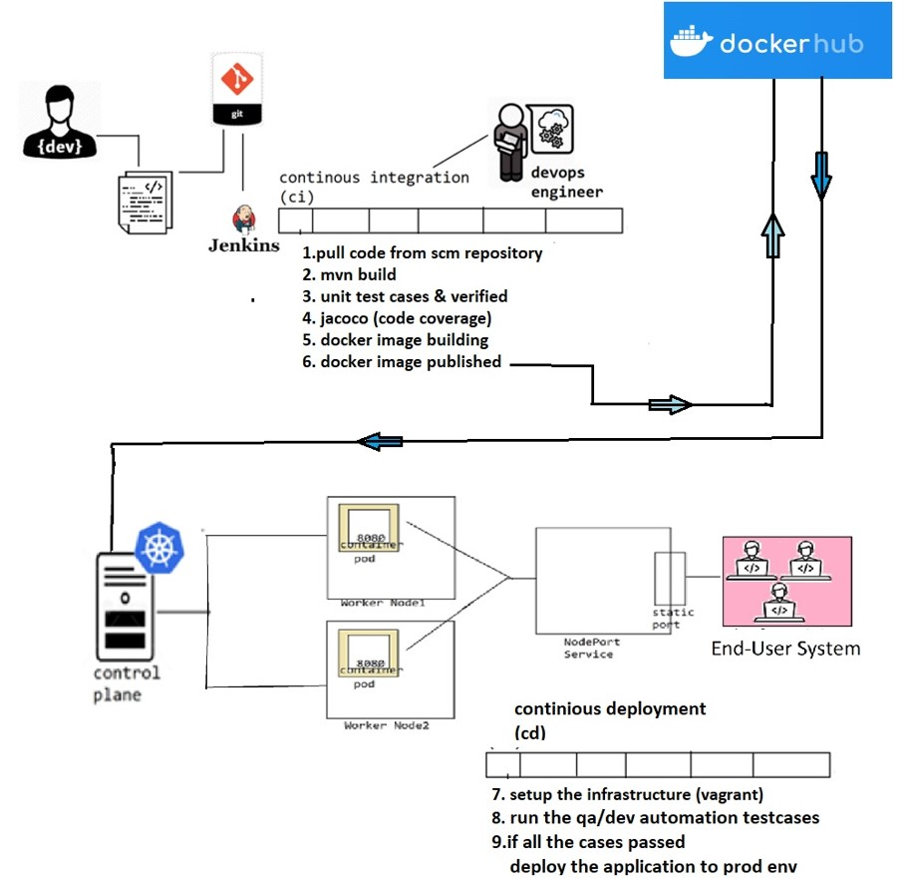
Project Workflow

Slide 7
CI/CD Pipeline

Slide 8



Monitoring Solutions
Kiali
Promatheus
Grafana
Kiali is an observability console for Istio, which is a popular open-source service mesh platform.
It provides a graphical interface to visualize the topology of your microservices, monitor traffic flow, and troubleshoot issues in a microservices architecture.
Kiali helps in understanding how different microservices interact with each other within an Istio service mesh.
Prometheus is an open-source monitoring and alerting toolkit designed for reliability and scalability.
It is primarily used for collecting and querying time-series data, making it well-suited for monitoring and alerting purposes.
Prometheus is often integrated with Grafana for creating dashboards and visualizing the collected metrics
Grafana is an open-source analytics and monitoring platform
It provides a web-based interface for creating and viewing dashboards with various data sources, including time-series databases like Prometheus, Elasticsearch, InfluxDB, and others.
Grafana is often used to visualize and analyze metrics and logs from different systems and applications

Slide 9
Conclusion
The implementation of zero-touch resilience minimizes the impact of failures by automating recovery processes. Automated health checks, retries, and circuit breakers contribute to a more resilient and reliable system.
Complement zero-touch resilience with comprehensive disaster recovery planning.
Identify critical components, establish backup strategies, and conduct regular drills to validate the effectiveness of recovery procedures.
The integration of DevOps principles encourages collaboration between development and operations teams, breaking down silos and fostering shared responsibility for the entire software delivery lifecycle.
Maintain clear communication channels between teams, ensuring that changes, updates, and incidents are communicated effectively. Collaboration tools and documentation play a crucial role in facilitating transparent communication.

Slide 10


Slide 11


